Slide 1
Applied deep learning
Project
Name: Yi Jiang
Uni: yj2563

Slide 2
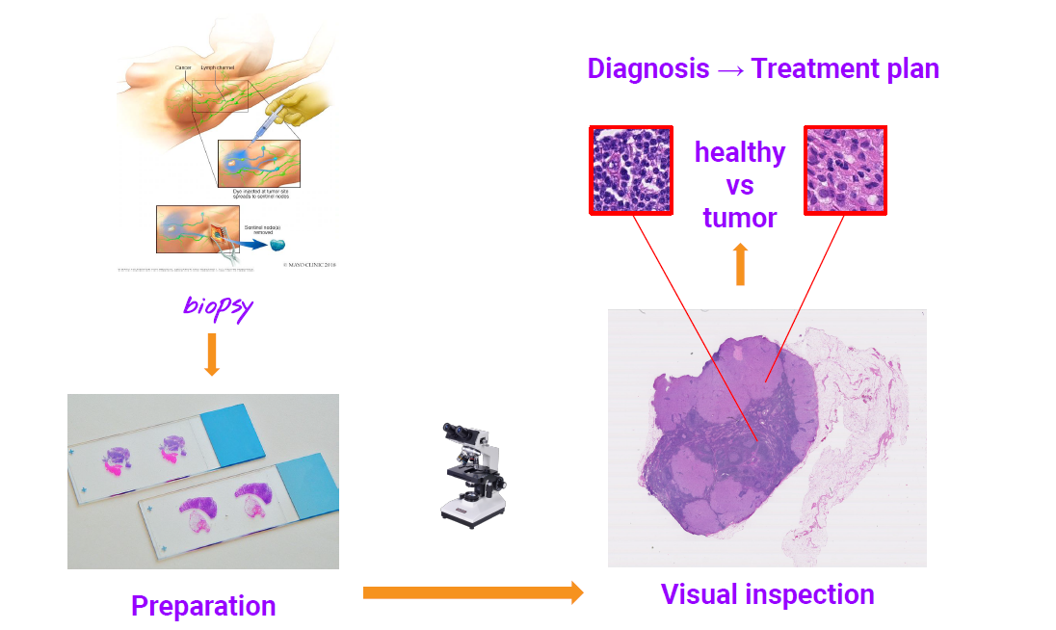
Purpose
Develop a tool to assist physicians
Given a collection of training data, develop a model that outputs a heatmap, showing regions of a biopsy image likely to contain cancer.

Slide 3
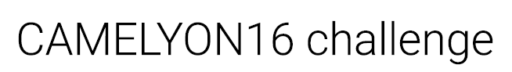
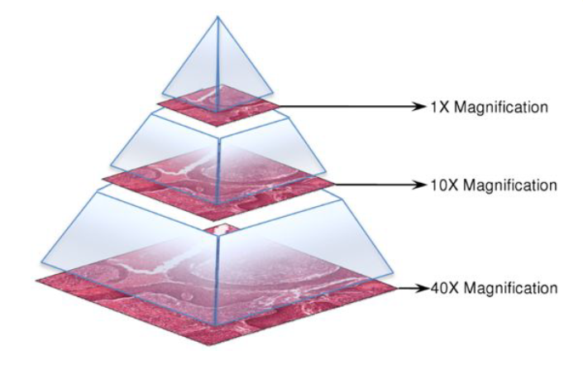
Dataset
Each image has at least 7 level, which means level 0 has most pixel and level 7 or highest level has fewer pixel. For example, the level 0 of image 091 has 61440 * 53760 pixel and the level 7 has 480 * 420 pixel.
Tissue images and diagnosis

Slide 4
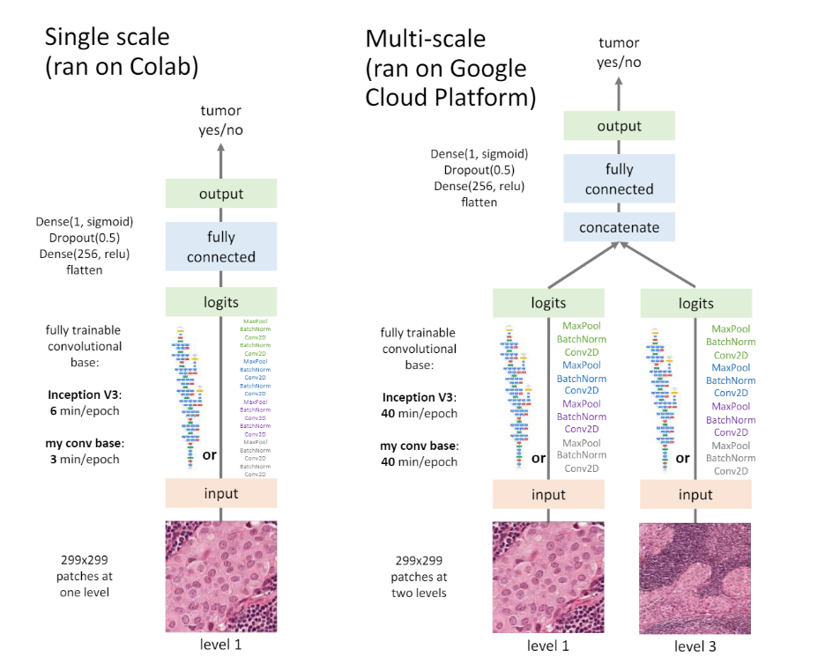
Method
Read image(openslide)
Extract patch
Split train and validation dataset
Model(single input, multiple input)
Training model
Generate heatmap

Slide 5
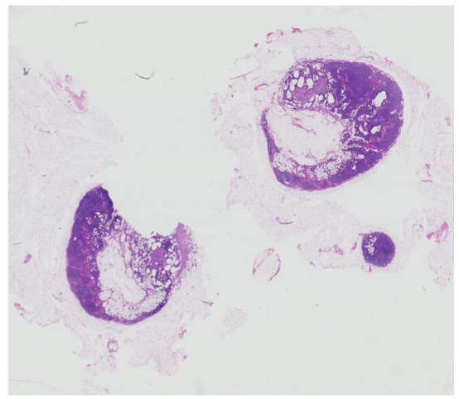
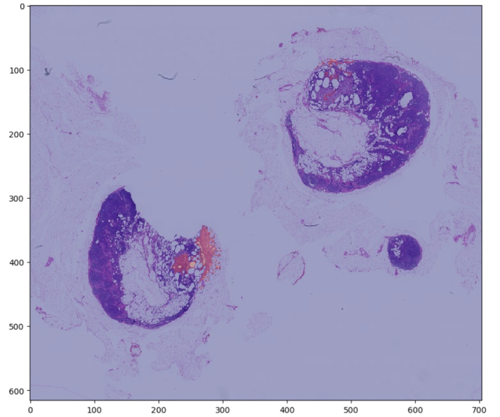
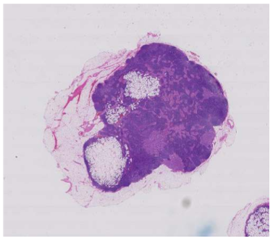
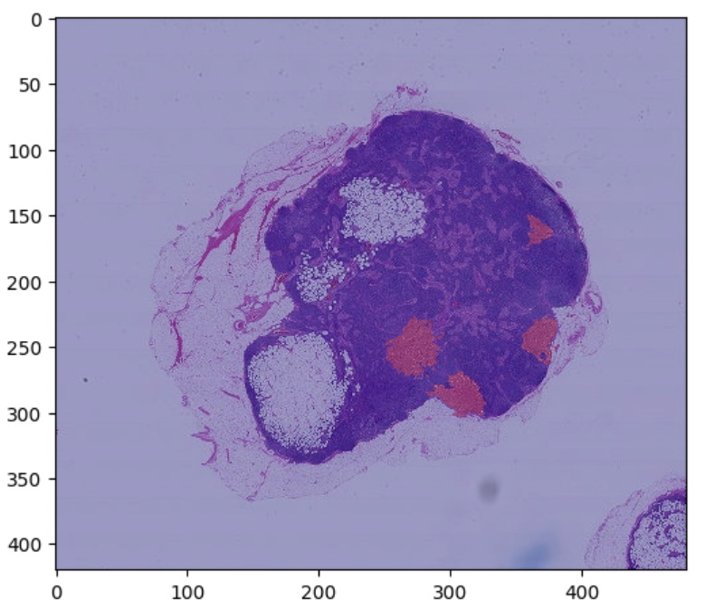
Read image
Tumor
Tumor with mask

Slide 6
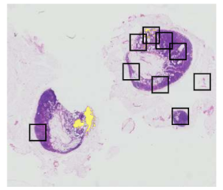
Extract patch
choose 200 bad and 200 healthy patch each image. the sample point is the pixel extracted from the tumor image and then use the coordinate to create patch, width*height is 299*299. To be specific, cancer patch center is the coordinate where mask image matric value equals to 1, and healthy patch is all tissue coordinate except cancer patch center. And then choose 400 patches randomly from whole image.
My work
Single input : level 5
Multiple input: level 5 and level 4

Slide 7
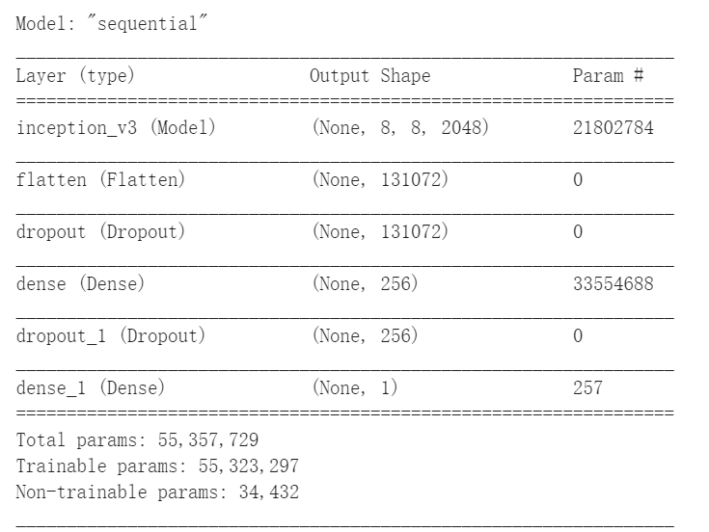
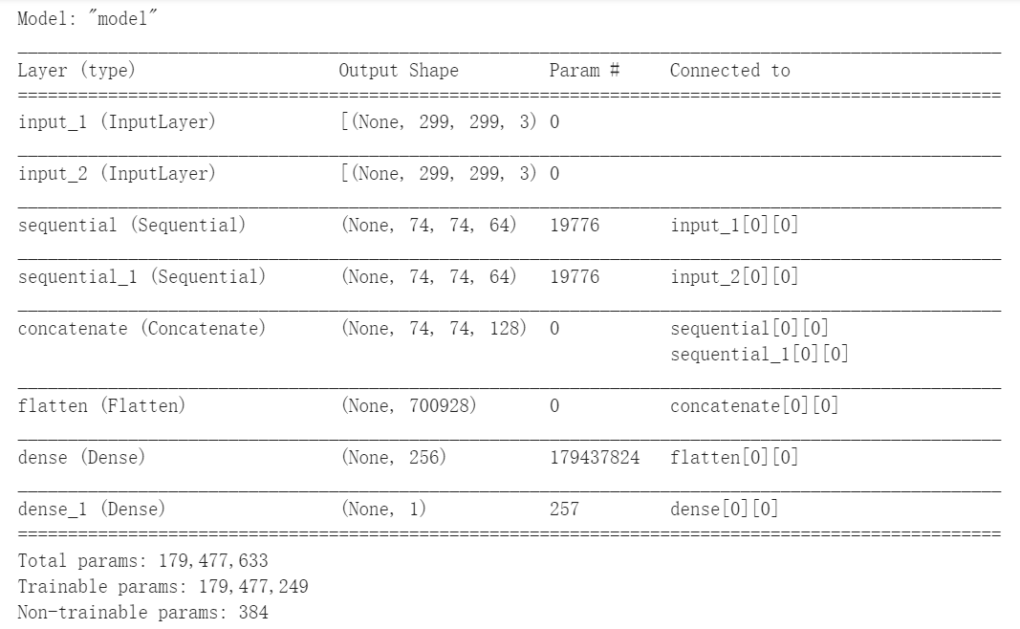
Model
Single input
Transfer learning:
InceptionV3 + dense layer
Multiple input
Each model has two convolution layers and concatenate two outputs as input to the dense layer.( relu and sigmoid)

Slide 8
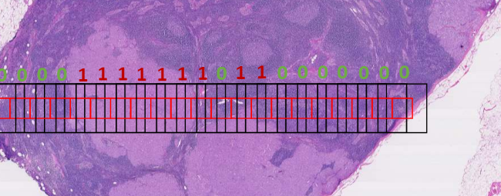
Generate heatmap
The point of drawing heat map is creating a matrices like mask image, which means the value of each pixel of image stands for the probability of having cancer. And the value is the result of model prediction.
My work
choose some pixel (up to 2000) in level 7
use these pixel coordinates as the center of a patch on level 5
predict that patches on my model
Put every predict value of chosen pixel into the heat map matrix of level 7 image

Slide 9
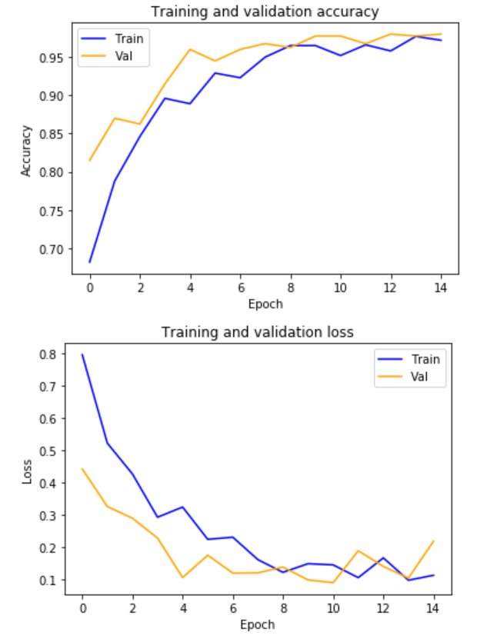
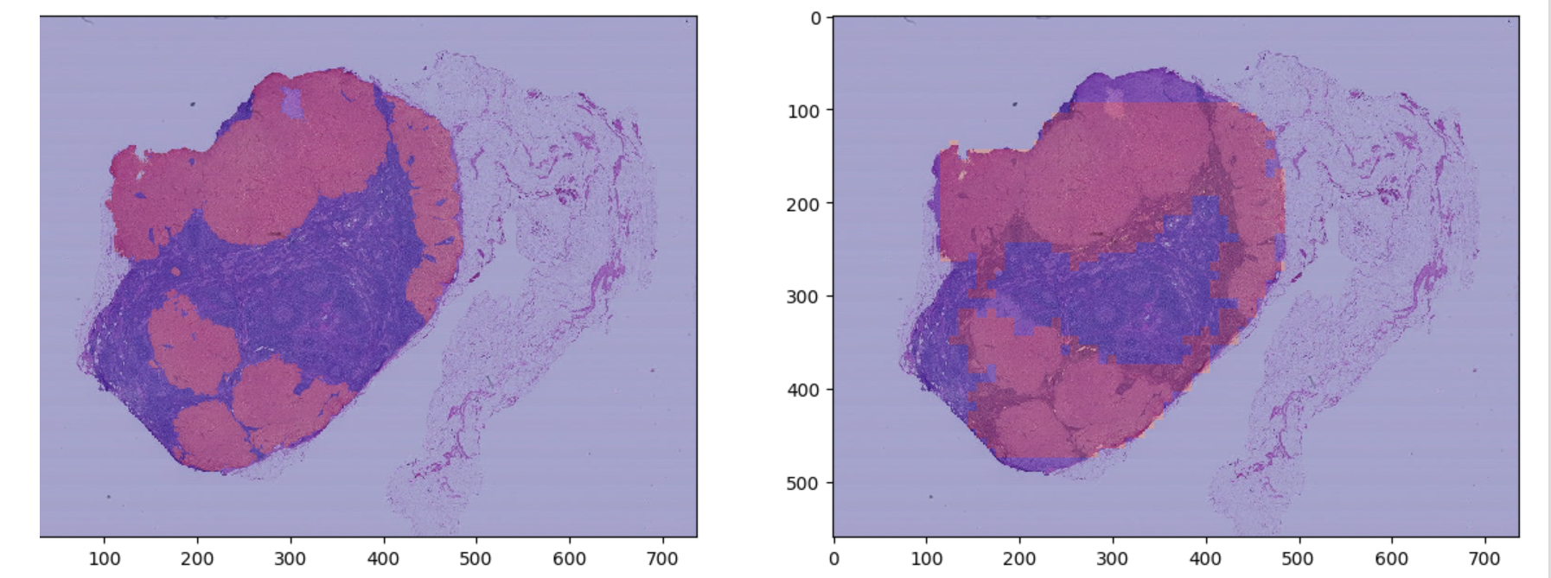
Result
Single input
Accuracy & loss plot
Heat map

Slide 10
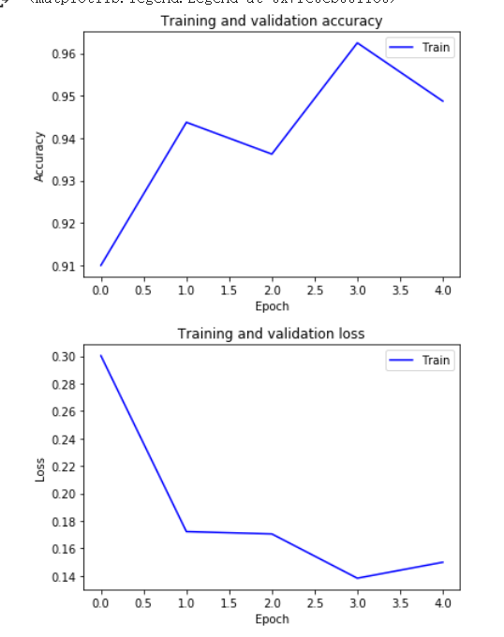
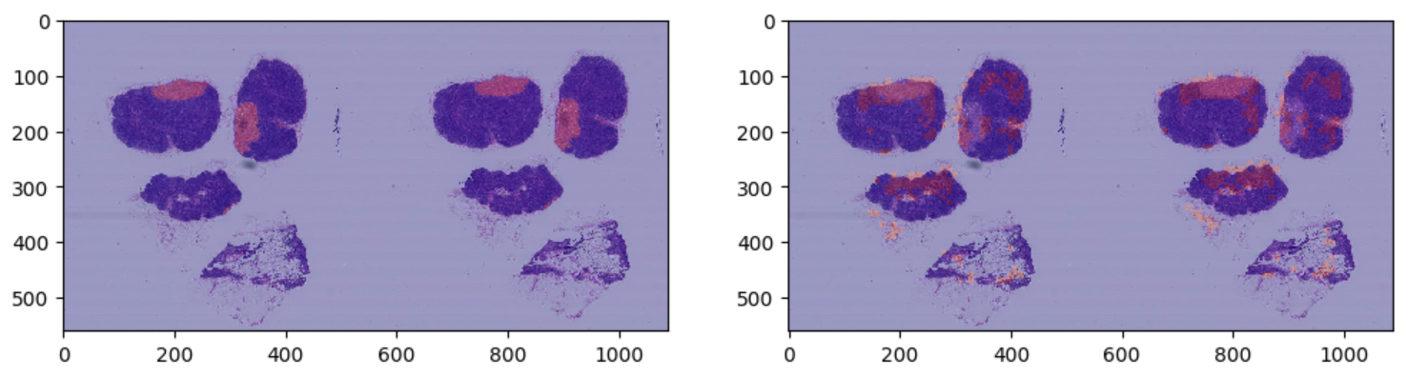
Result
Multiple input
Accuracy & loss plot
Heat map

Slide 11
Analyze
Theoretically, the result of multi-input model is better than result of single-input model. However, in this assignment, because the multi-input model is so large that each time I run it, the Colab will be crushed due to RAM filled. In this case, my model is much easy and the number of dataset is not sufficient. I also leave out validation data.

Slide 12
Coding Part

Slide 13
Thank you

